Slide 1
Automated in-situ sensors & Spatiotemporal Monitoring & Machine Learning prediction of Harmful Algal Blooms - Case Study-Lake Victoria
Presenter:
Name: OKELLO, JACOB OKOMO
Reg. No: ENC222-0149/2017

Slide 2
Introduction
Toxic Cyanobacteria-rich Harmful Algal Blooms (CyanoHABs) , a phenomenon in which the water body e.g. lakes turns dark blue-green due to excessive algal growth; potentially harming humans and animal, e.g., Unsightly nuisance, acute liver damage when ingested, irritation, fish deaths, whatnot.
- WHO
Hence, quantifying the detailed spatial distributions of CyanoHABs in L. Victoria on a regular and frequent basis is of great significance, which requires high spatiotemporal resolution monitoring abilities- (Sitoki et al., 2012)
There however exists that niche to support the near-real time space observations with a geointelligent reporting system and further predict any looming bloom.

Slide 3
Problem statement
The rapidly escalating demographics along L. Victoria riparian reserves has negatively impacted water quality through deposits of agricultural, industrial runoff and sewer refuse eutrophicating the said region. (Burkholder et al., 2006; MOH)
The research will in turn After reviewing the papers and gaps – what exactly is the problem? state this explicitly.
Ensure you mention the problem, area, and in detail the problem specifics

Slide 4
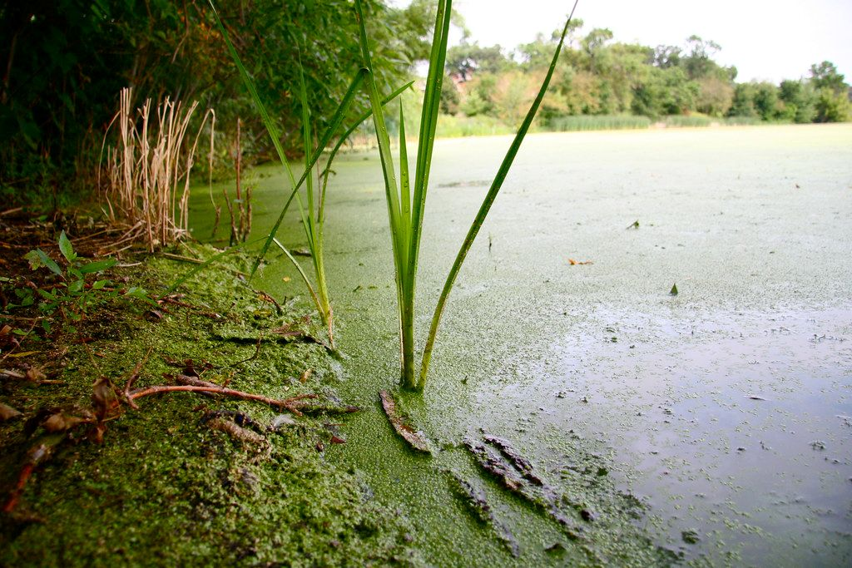
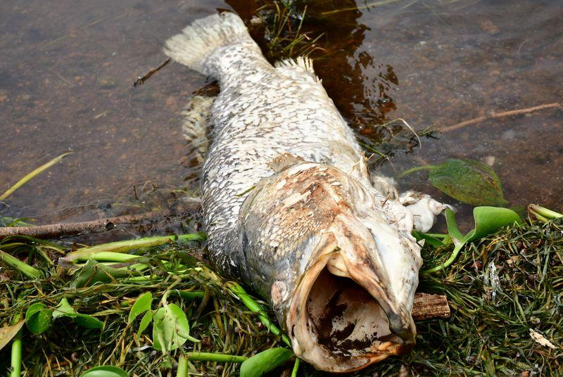
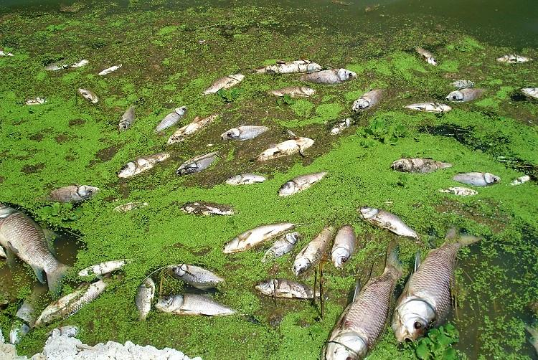
Justification

Slide 5
General and specific objectives
To monitor and predict the occurrence of Harmful Algal Blooms(HABs) and Cyanobacteria.
To develop automated in-situ Internet of Things(IoT) sensors to monitor the occurrence of the event.
To develop a system that reports specified geo-tagged data from the above sensors.
To associate Machine Learning models to predict the occurrence of CynoHAB.

Slide 6
Overall Methodology : Data and Materials
Data & Materials;
Data Type | Source | Access
Shapefiles | Database of Global Administrative Areas- GADM | Free
MODIS Aqua | Google Earth Engine Cloud Repo | Free
Landsat 8 OLI | Google Earth Engine Cloud Repo | Free
- Meteorology Data -In-Situ | -Lake Victoria Water Quality Mgt -My Automated In-situ System | -Uncertain -Within my control
Tool/ Material | Role | Availability
Google Earth Engine | Geocomputation & Processing | Freely Available
QGIS, R & Python | Further Analysis, Maps & Prediction | Free
Microcontroller, Sensors & Gateway | In-situ data collection & Monitoring | Local Purchase

Slide 7
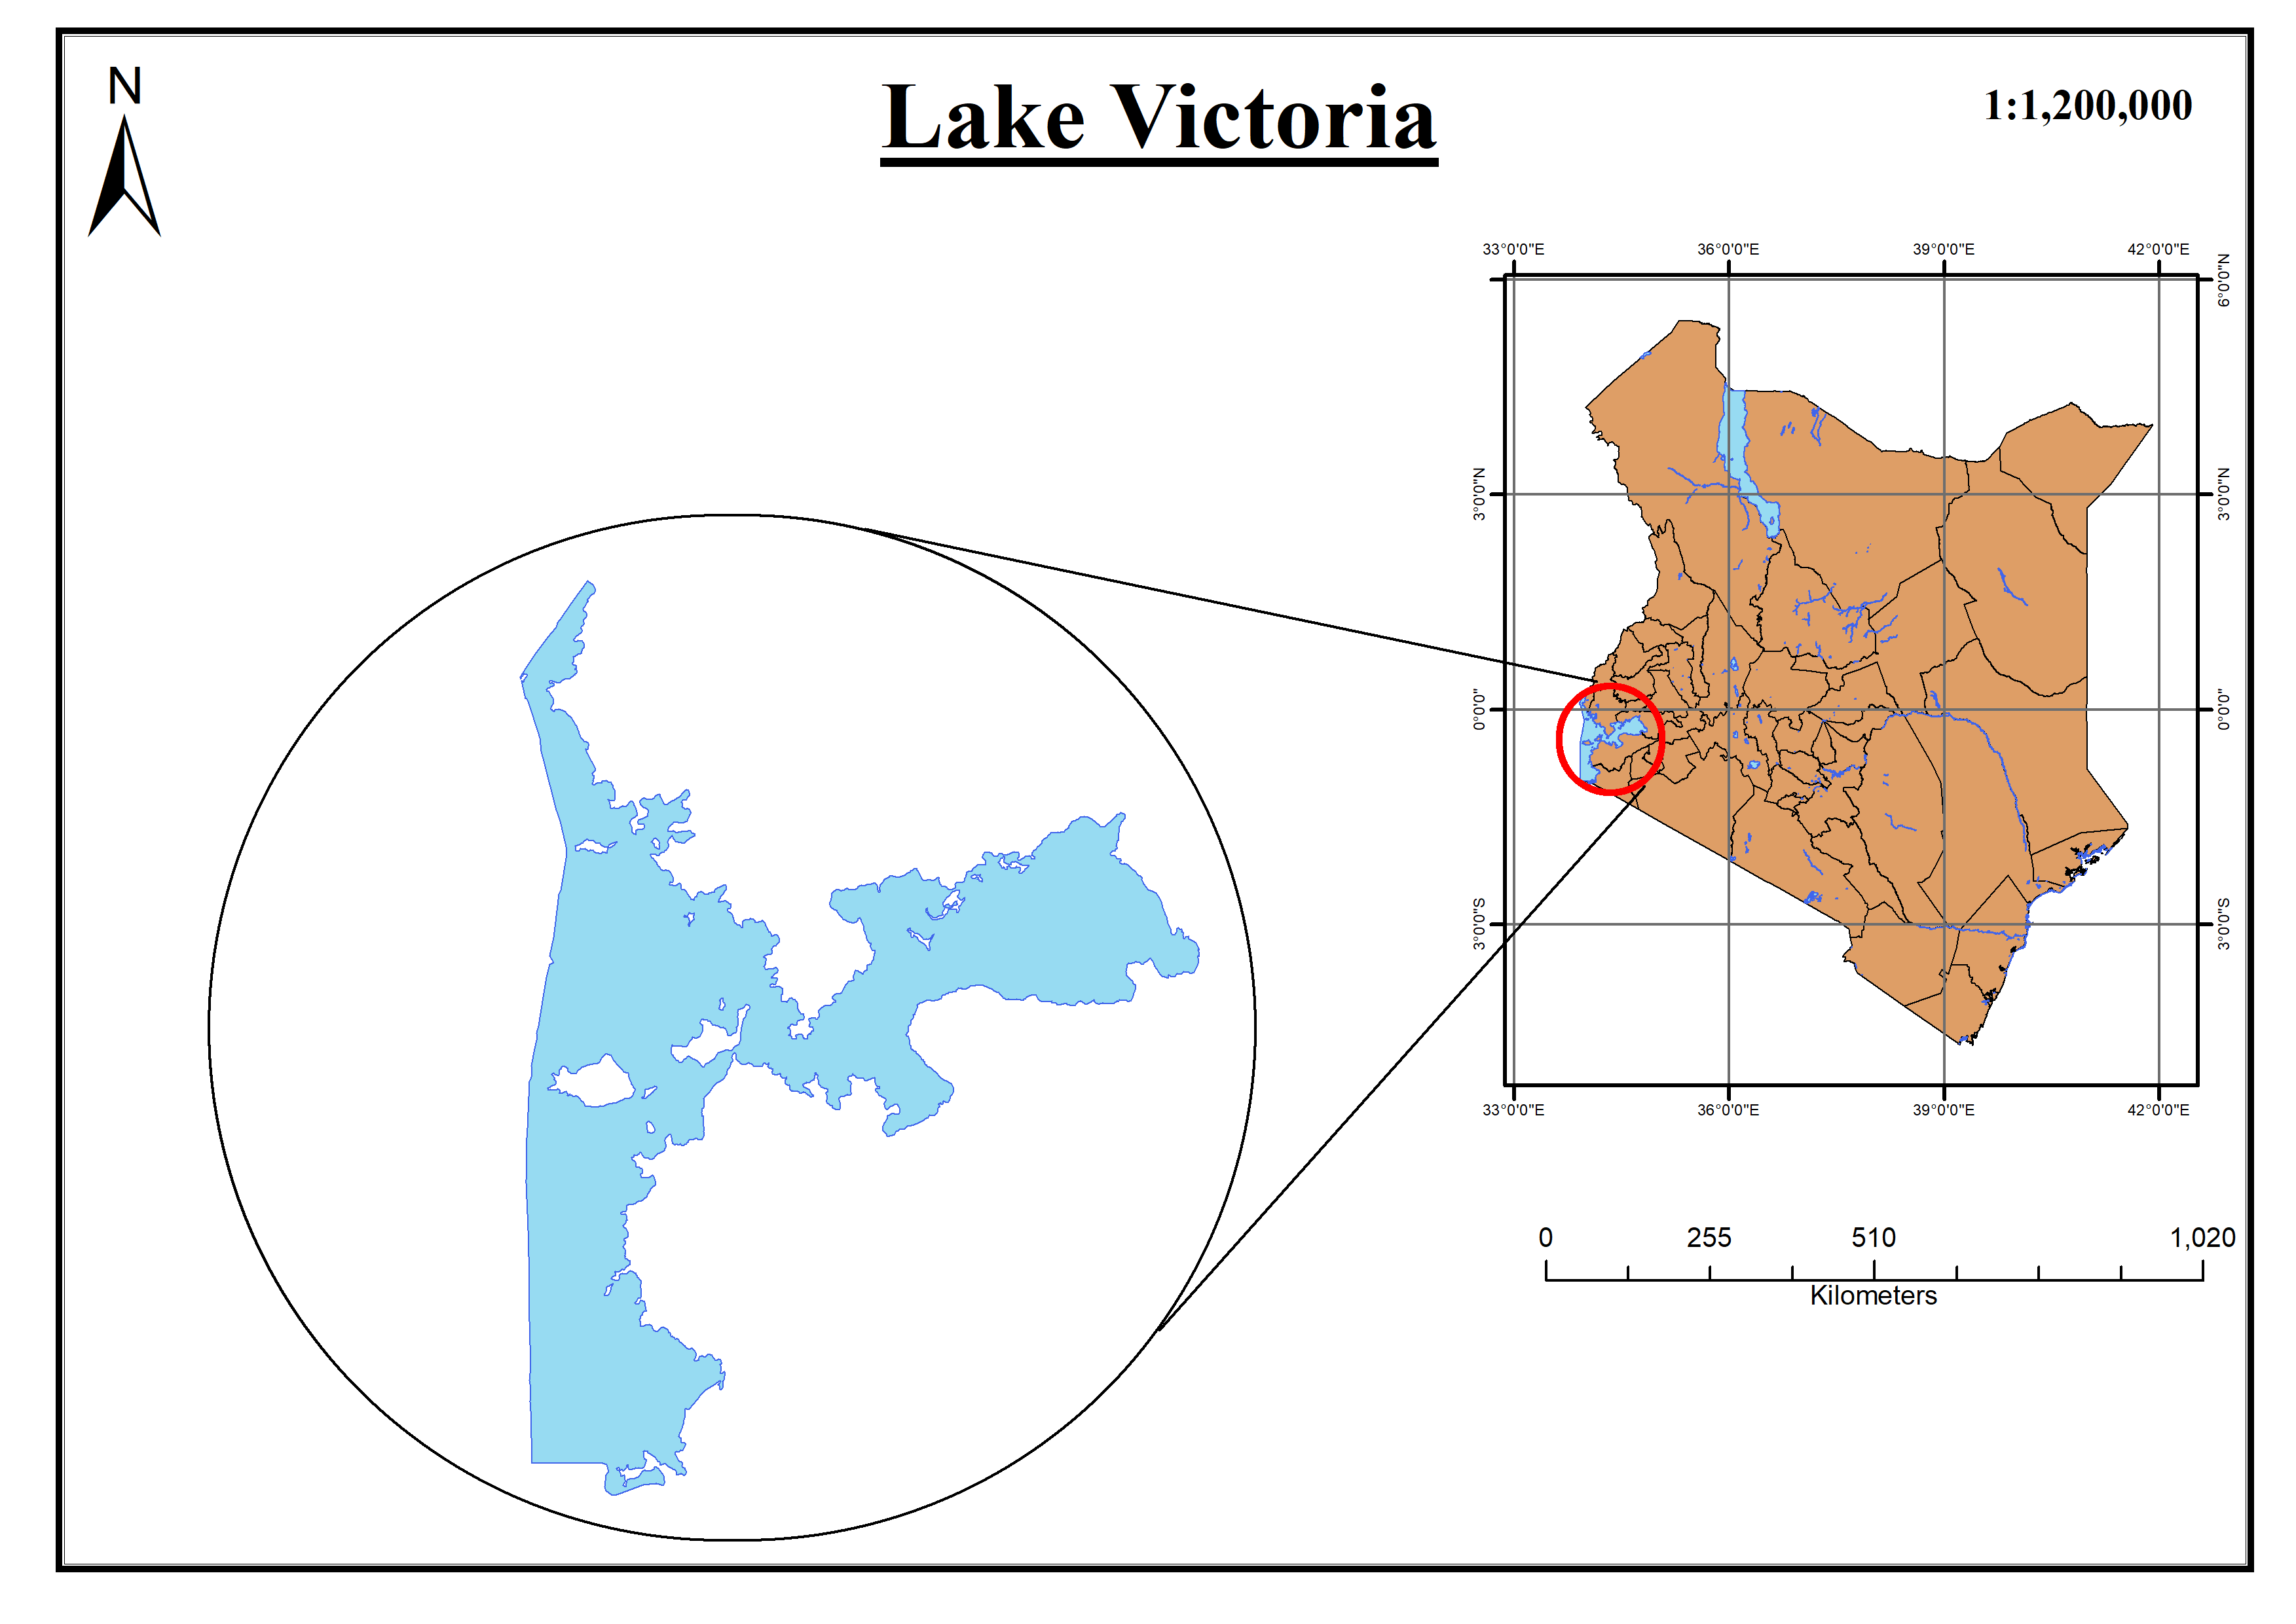
Study Area

Slide 8
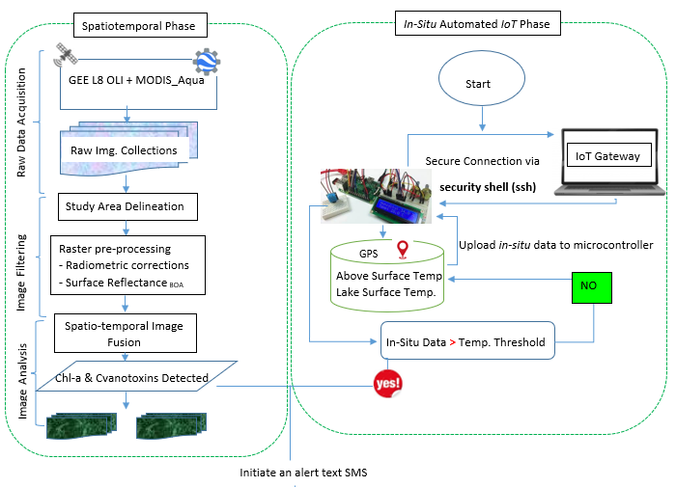
Overall methodology

Slide 9
Expected Results
Chlorophyl-a Geographical Maps associating the occurrence of the Harmful Algal Blooms and Cyanobacteria.
Automated system that monitors and reports geo-tagged data
Reported confirmation alert Text SMS reporting in near-real time the in-situ status from the sensors.
Time Series predictive model on any looming bloom.

Slide 10
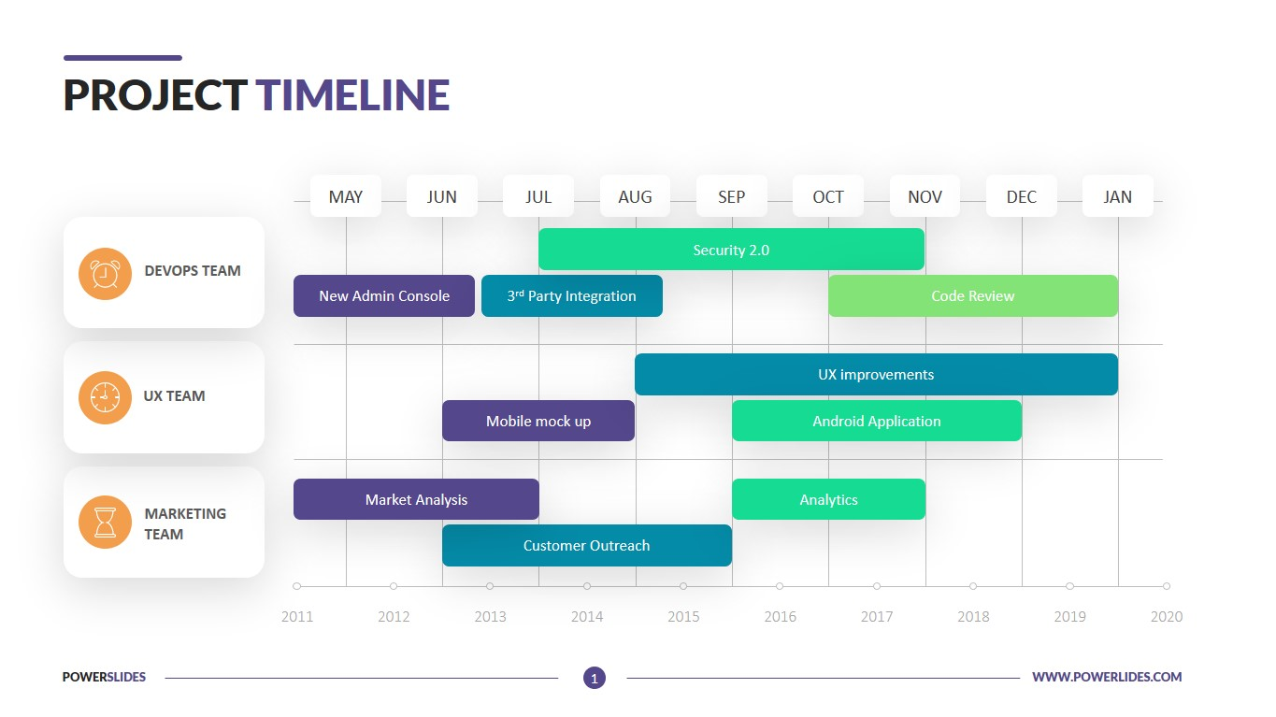
Project Timeline

Slide 11

Thank you for your attention! Questions?

